Slide 1


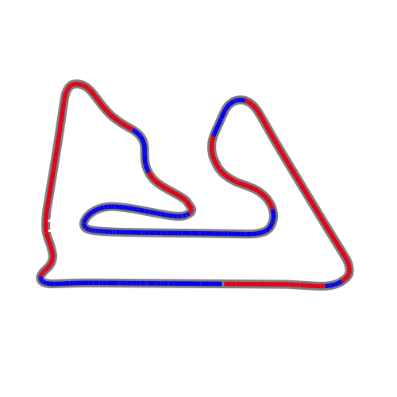


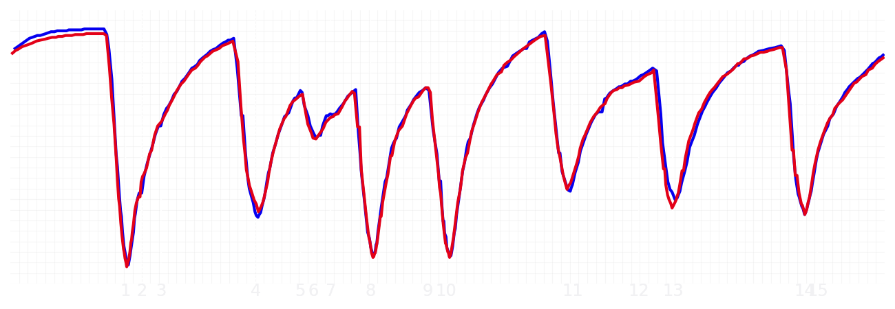
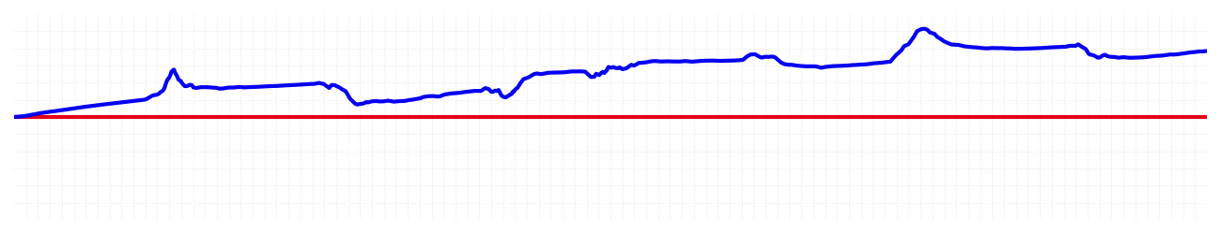
Bahrain GP Qualifying Q1
Max Verstappen
Driver
Yuki Tsunoda
Driver
Lap Time
01:31.303
01:31.751
Lap Time
Sector 1
29.121
Speed Trap 1
242 kp/h
Speed Trap 1
241 kp/h
Sector 1
29.264
Sector 2
39.288
Speed Trap 2
275 kp/h
Gap
-0.448
Gap
0.448
Speed Trap 2
272 kp/h
Sector 2
39.531
Sector 3
22.894
Speed Final Line
287 kp/h
Corner Advantage
7/16
Corner Advantage
9/16
Speed Final Line
284 kp/h
Sector 3
22.956
FULL THROTTLE
60%
61%
FULL THROTTLE
HEAVY BREAKING
20%
18%
HEAVY BREAKING
%LAP TIME
CORNERING
20%
21%
CORNERING
%LAP TIME
SPEED
SPEED
DELTA TIME
DELTA TIME

Slide 2

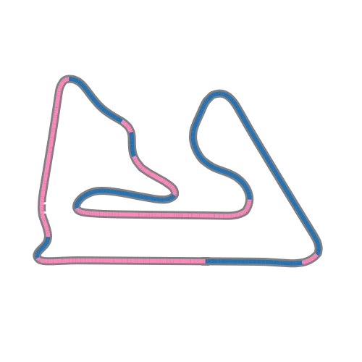


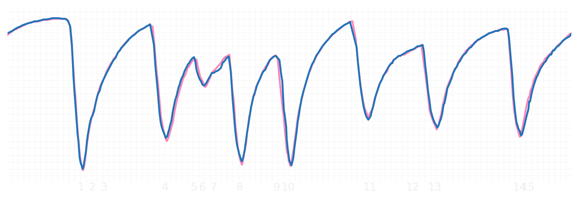
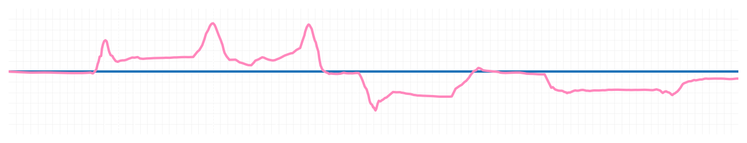
Bahrain GP Qualifying Q1
Pierre Gasly
Driver
Jack Doohan
Driver
Lap Time
01:31.462
01:31.414
Lap Time
Sector 1
29.356
Speed Trap 1
241 kp/h
Speed Trap 1
244 kp/h
Sector 1
29.239
Sector 2
39.267
Speed Trap 2
272 kp/h
Gap
0.048
Gap
-0.048
Speed Trap 2
273 kp/h
Sector 2
39.259
Sector 3
22.839
Speed Final Line
288 kp/h
Corner Advantage
8/16
Corner Advantage
8/16
Speed Final Line
289 kp/h
Sector 3
22.916
FULL THROTTLE
62%
61%
FULL THROTTLE
HEAVY BREAKING
19%
19%
HEAVY BREAKING
%LAP TIME
CORNERING
19%
20%
CORNERING
%LAP TIME
SPEED
SPEED
DELTA TIME
DELTA TIME

Slide 3

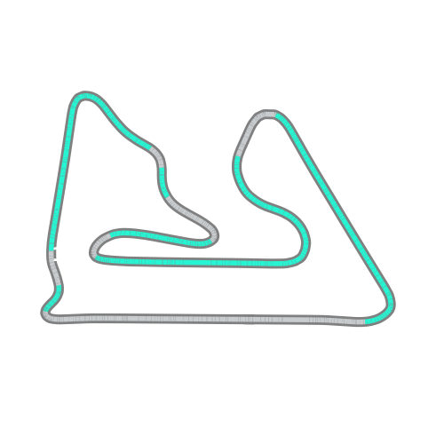


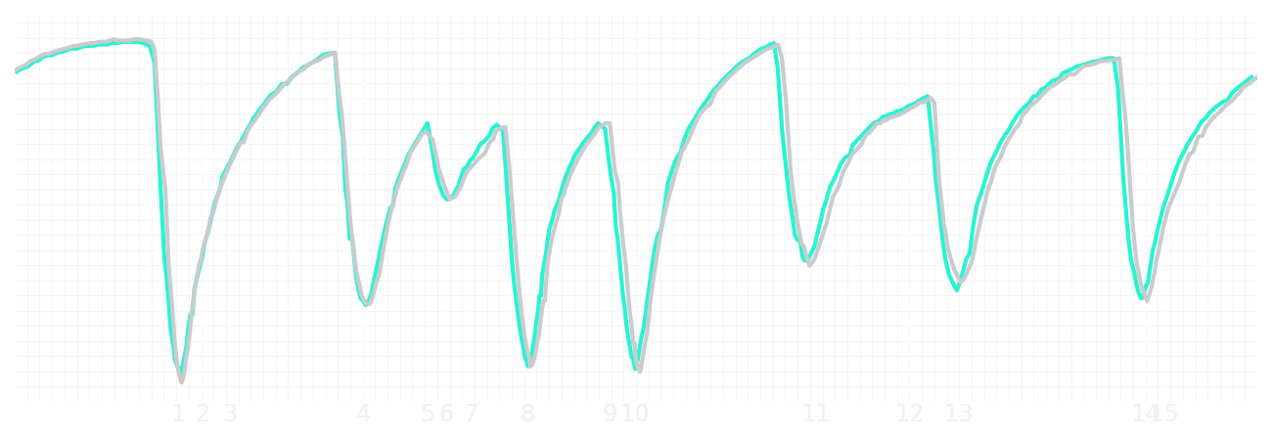
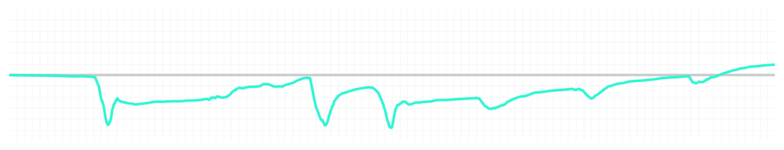
Bahrain GP Qualifying Q1
Kimi Antonelli
Driver
George Russell
Driver
Lap Time
01:31.415
01:31.494
Lap Time
Sector 1
29.348
Speed Trap 1
242 kp/h
Speed Trap 1
242 kp/h
Sector 1
29.223
Sector 2
39.426
Speed Trap 2
273 kp/h
Gap
-0.079
Gap
0.079
Speed Trap 2
272 kp/h
Sector 2
39.490
Sector 3
22.641
Speed Final Line
287 kp/h
Corner Advantage
6/16
Corner Advantage
10/16
Speed Final Line
287 kp/h
Sector 3
22.781
FULL THROTTLE
61%
61%
FULL THROTTLE
HEAVY BREAKING
19%
18%
HEAVY BREAKING
%LAP TIME
CORNERING
20%
21%
CORNERING
%LAP TIME
SPEED
SPEED
DELTA TIME
DELTA TIME

Slide 4

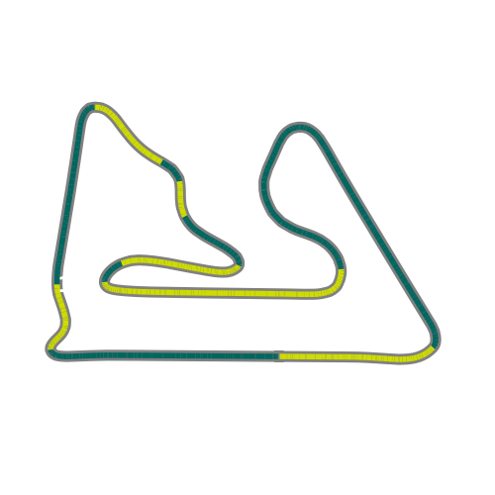


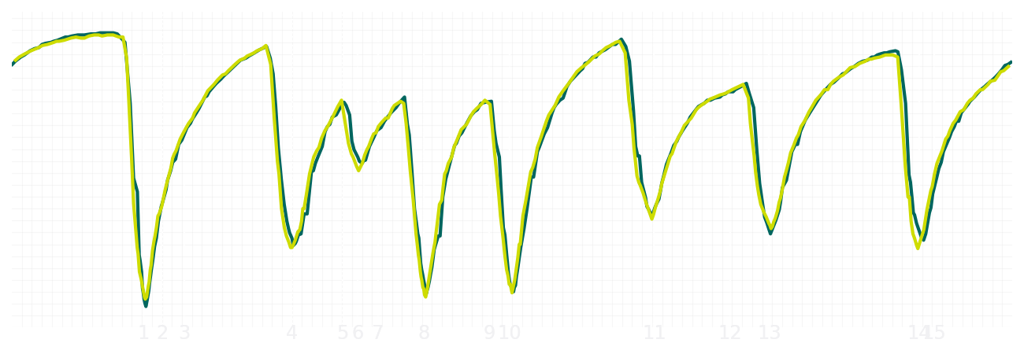
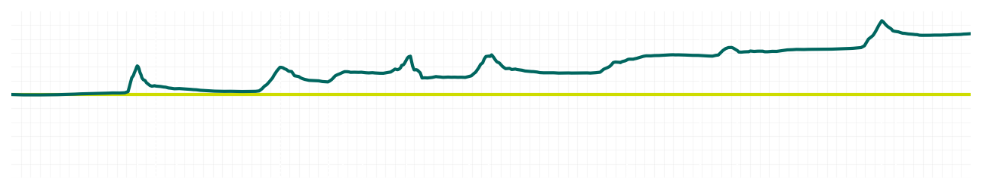
Bahrain GP Qualifying Q1
Fernando Alonso
Driver
Lance Stroll
Driver
Lap Time
01:31.634
01:32.283
Lap Time
Sector 1
29.231
Speed Trap 1
243 kp/h
Speed Trap 1
242 kp/h
Sector 1
29.282
Sector 2
39.502
Speed Trap 2
269 kp/h
Gap
-0.649
Gap
0.649
Speed Trap 2
270 kp/h
Sector 2
39.858
Sector 3
22.901
Speed Final Line
287 kp/h
Corner Advantage
8/16
Corner Advantage
8/16
Speed Final Line
284 kp/h
Sector 3
23.143
FULL THROTTLE
61%
63%
FULL THROTTLE
HEAVY BREAKING
20%
18%
HEAVY BREAKING
%LAP TIME
CORNERING
19%
19%
CORNERING
%LAP TIME
SPEED
SPEED
DELTA TIME
DELTA TIME

Slide 5

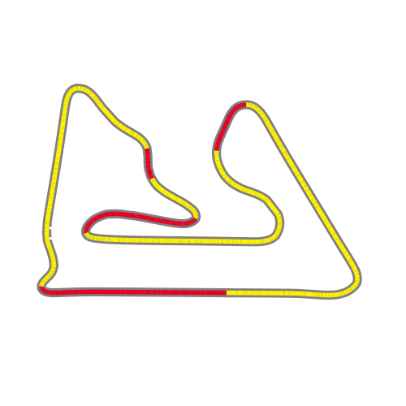


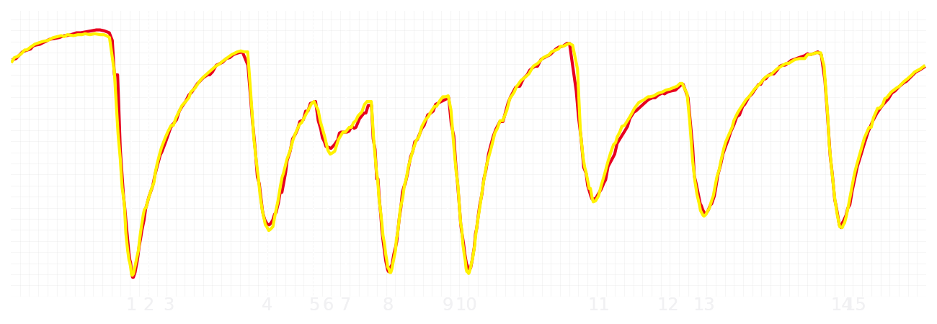
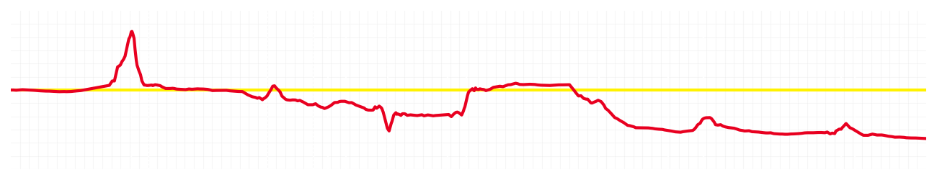
Bahrain GP Qualifying Q1
Charles Leclerc
Driver
Lewis Hamilton
Driver
Lap Time
01:31.454
01:31.219
Lap Time
Sector 1
28.967
Speed Trap 1
242 kp/h
Speed Trap 1
243 kp/h
Sector 1
28.966
Sector 2
39.606
Speed Trap 2
269 kp/h
Gap
0.235
Gap
-0.235
Speed Trap 2
271 kp/h
Sector 2
39.466
Sector 3
22.881
Speed Final Line
287 kp/h
Corner Advantage
11/16
Corner Advantage
5/16
Speed Final Line
286 kp/h
Sector 3
22.787
FULL THROTTLE
56%
62%
FULL THROTTLE
HEAVY BREAKING
22%
21%
HEAVY BREAKING
%LAP TIME
CORNERING
22%
17%
CORNERING
%LAP TIME
SPEED
SPEED
DELTA TIME
DELTA TIME

Slide 6

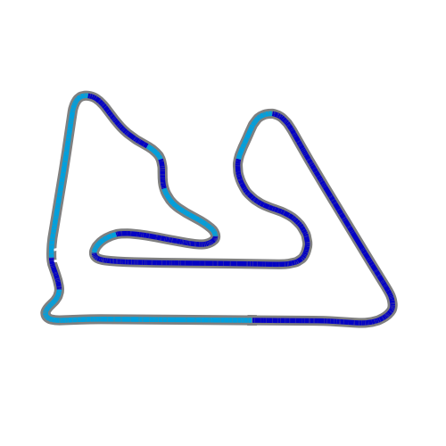


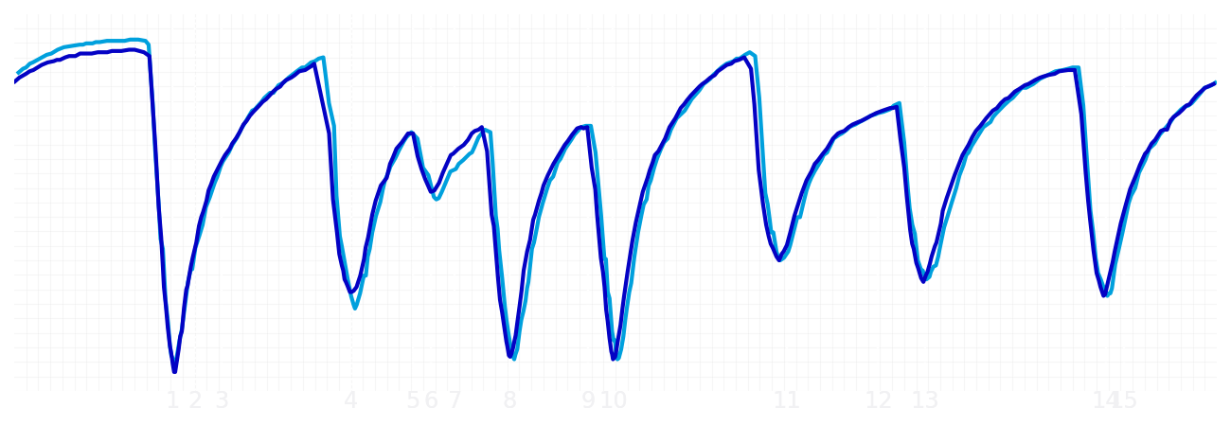
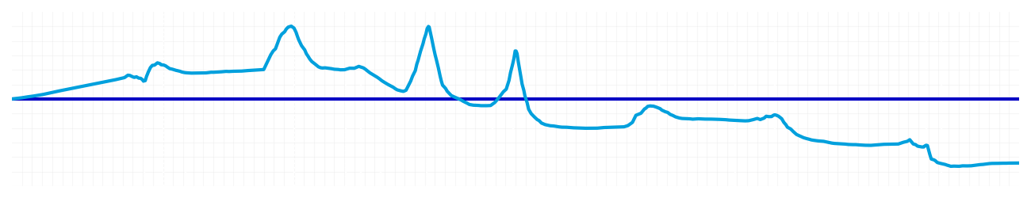
Bahrain GP Qualifying Q1
Alexander Albon
Driver
Carlos Sainz
Driver
Lap Time
01:32.040
01:31.591
Lap Time
Sector 1
29.227
Speed Trap 1
242 kp/h
Speed Trap 1
242 kp/h
Sector 1
29.211
Sector 2
39.776
Speed Trap 2
272 kp/h
Gap
0.449
Gap
-0.449
Speed Trap 2
269 kp/h
Sector 2
39.521
Sector 3
23.037
Speed Final Line
287 kp/h
Corner Advantage
8/16
Corner Advantage
8/16
Speed Final Line
285 kp/h
Sector 3
22.859
FULL THROTTLE
59%
63%
FULL THROTTLE
HEAVY BREAKING
20%
20%
HEAVY BREAKING
%LAP TIME
CORNERING
21%
17%
CORNERING
%LAP TIME
SPEED
SPEED
DELTA TIME
DELTA TIME

Slide 7

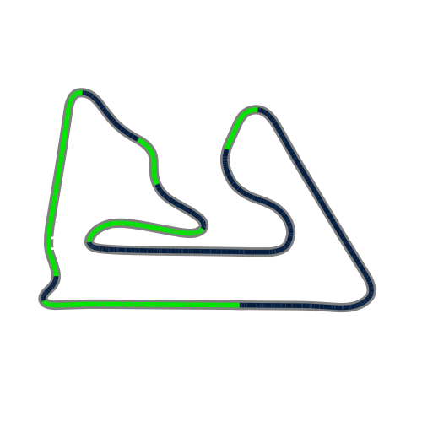


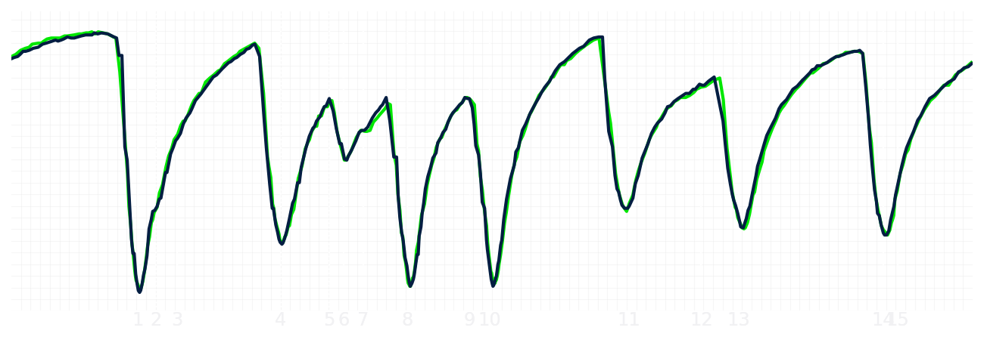
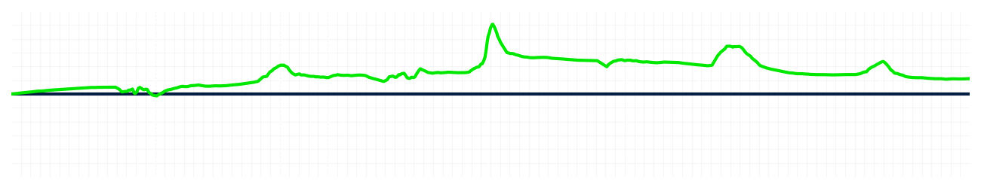
Bahrain GP Qualifying Q1
Nico Hulkenberg
Driver
Gabriel Bortoleto
Driver
Lap Time
01:32.067
01:32.186
Lap Time
Sector 1
29.400
Speed Trap 1
243 kp/h
Speed Trap 1
242 kp/h
Sector 1
29.577
Sector 2
39.490
Speed Trap 2
274 kp/h
Gap
-0.119
Gap
0.119
Speed Trap 2
276 kp/h
Sector 2
39.608
Sector 3
23.177
Speed Final Line
288 kp/h
Corner Advantage
8/16
Corner Advantage
8/16
Speed Final Line
286 kp/h
Sector 3
23.001
FULL THROTTLE
59%
59%
FULL THROTTLE
HEAVY BREAKING
22%
22%
HEAVY BREAKING
%LAP TIME
CORNERING
19%
19%
CORNERING
%LAP TIME
SPEED
SPEED
DELTA TIME
DELTA TIME

Slide 8

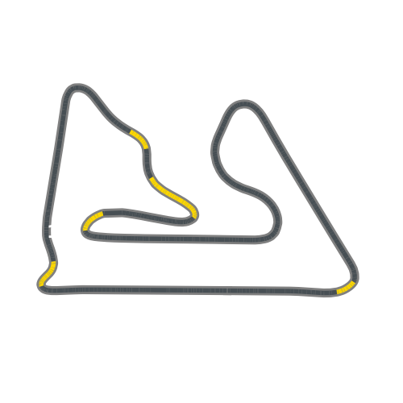


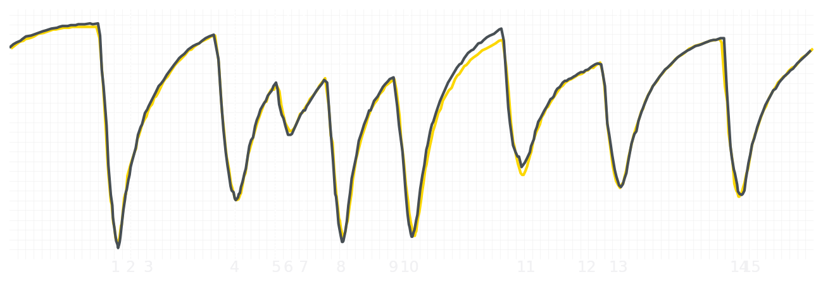
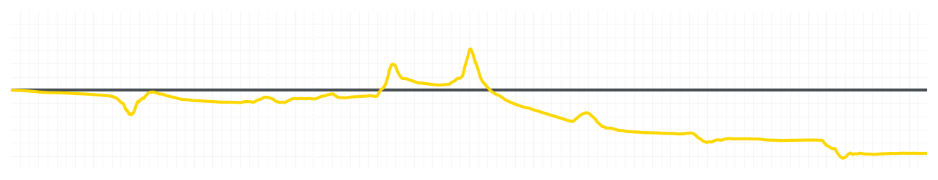
Bahrain GP Qualifying Q1
Liam Lawson
Driver
Isack Hadjar
Driver
Lap Time
01:32.165
01:31.591
Lap Time
Sector 1
29.327
Speed Trap 1
241 kp/h
Speed Trap 1
241 kp/h
Sector 1
29.232
Sector 2
39.880
Speed Trap 2
275 kp/h
Gap
0.574
Gap
-0.574
Speed Trap 2
276 kp/h
Sector 2
39.508
Sector 3
22.958
Speed Final Line
287 kp/h
Corner Advantage
10/16
Corner Advantage
6/16
Speed Final Line
287 kp/h
Sector 3
22.851
FULL THROTTLE
60%
61%
FULL THROTTLE
HEAVY BREAKING
20%
19%
HEAVY BREAKING
%LAP TIME
CORNERING
20%
20%
CORNERING
%LAP TIME
SPEED
SPEED
DELTA TIME
DELTA TIME

Slide 9

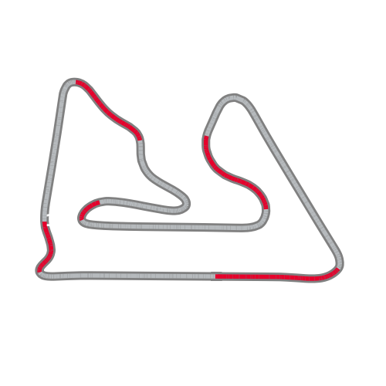


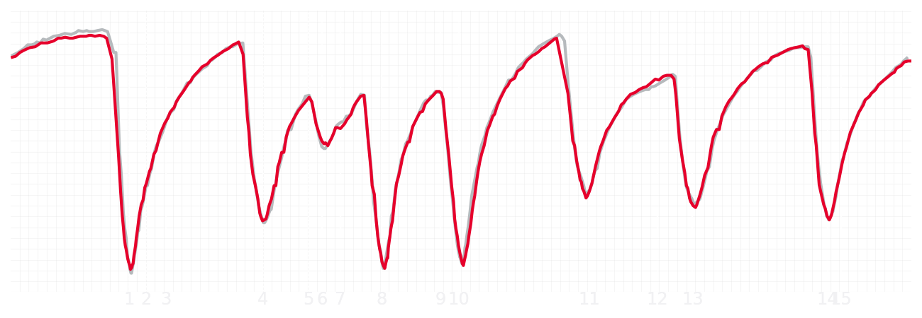
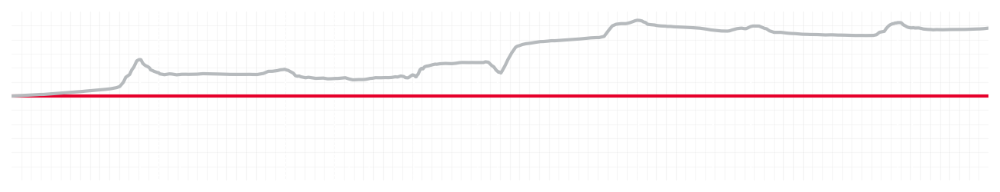
Bahrain GP Qualifying Q1
Esteban Ocon
Driver
Ollie Bearman
Driver
Lap Time
01:31.594
01:32.373
Lap Time
Sector 1
29.154
Speed Trap 1
243 kp/h
Speed Trap 1
241 kp/h
Sector 1
29.319
Sector 2
39.527
Speed Trap 2
271 kp/h
Gap
-0.779
Gap
0.779
Speed Trap 2
273 kp/h
Sector 2
40.089
Sector 3
22.913
Speed Final Line
289 kp/h
Corner Advantage
8/16
Corner Advantage
8/16
Speed Final Line
286 kp/h
Sector 3
22.965
FULL THROTTLE
61%
59%
FULL THROTTLE
HEAVY BREAKING
22%
22%
HEAVY BREAKING
%LAP TIME
CORNERING
17%
19%
CORNERING
%LAP TIME
SPEED
SPEED
DELTA TIME
DELTA TIME

Slide 10

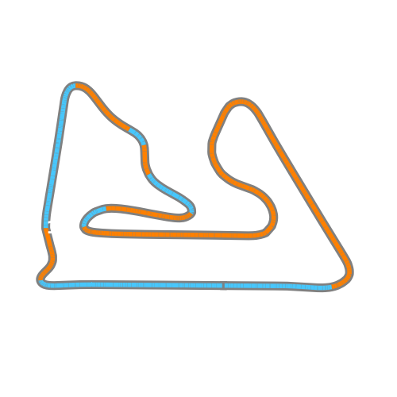


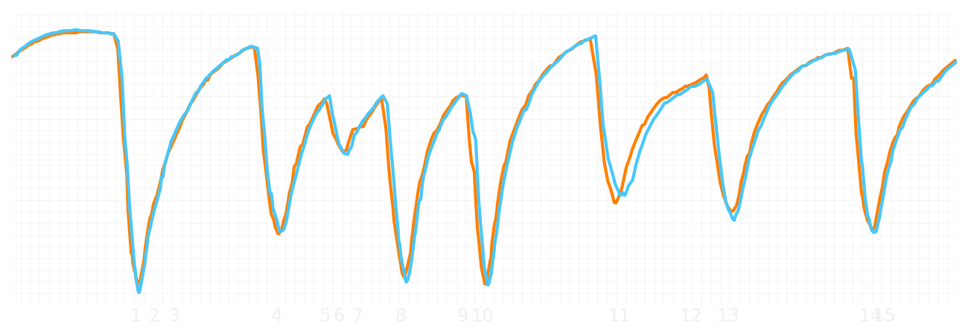
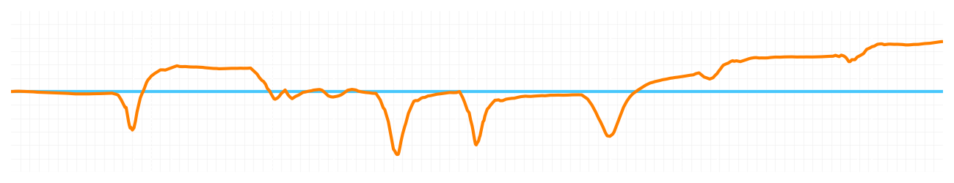
Bahrain GP Qualifying Q1
Lando Norris
Driver
Oscar Piastri
Driver
Lap Time
01:31.107
01:31.392
Lap Time
Sector 1
29.173
Speed Trap 1
243 kp/h
Speed Trap 1
243 kp/h
Sector 1
29.287
Sector 2
39.194
Speed Trap 2
273 kp/h
Gap
-0.285
Gap
0.285
Speed Trap 2
272 kp/h
Sector 2
39.300
Sector 3
22.740
Speed Final Line
286 kp/h
Corner Advantage
5/16
Corner Advantage
11/16
Speed Final Line
286 kp/h
Sector 3
22.805
FULL THROTTLE
63%
61%
FULL THROTTLE
HEAVY BREAKING
15%
18%
HEAVY BREAKING
%LAP TIME
CORNERING
22%
21%
CORNERING
%LAP TIME
SPEED
SPEED
DELTA TIME
DELTA TIME

